Slide 1

CORS and SSO

Slide 2
What is CORS errors?
Cross-Origin Resource Sharing
By default, Browsers restrict sharing cross origin
Different appearances of this error require different ways of resolving it
Notes:
https://developer.mozilla.org/en-US/docs/Web/HTTP/CORS
https://reactjs.org/docs/cross-origin-errors.html
https://daveceddia.com/access-control-allow-origin-cors-errors-in-react-express/

Slide 3
Think, Discuss, and Share
How can we navigate CORS and possible errors?

Slide 4
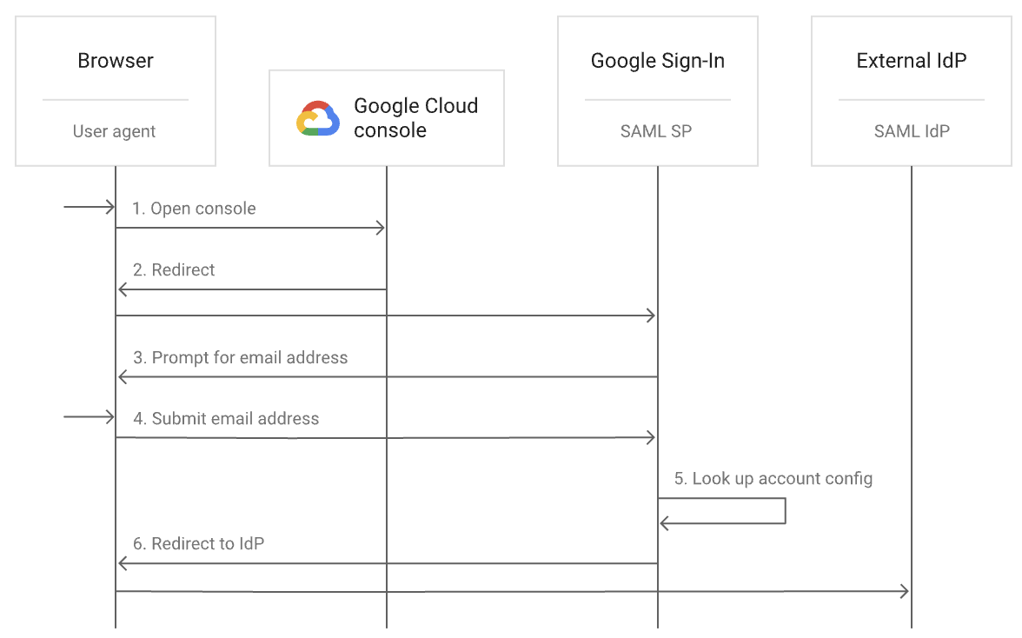
Single Sign-On
Each SSO provider has different tooling to help you set this up on your website or application
Notes:
https://cloud.google.com/architecture/identity/single-sign-on
https://developers.google.com/identity/protocols/oauth2
https://developers.facebook.com/docs/facebook-login/web/

